Slide 1
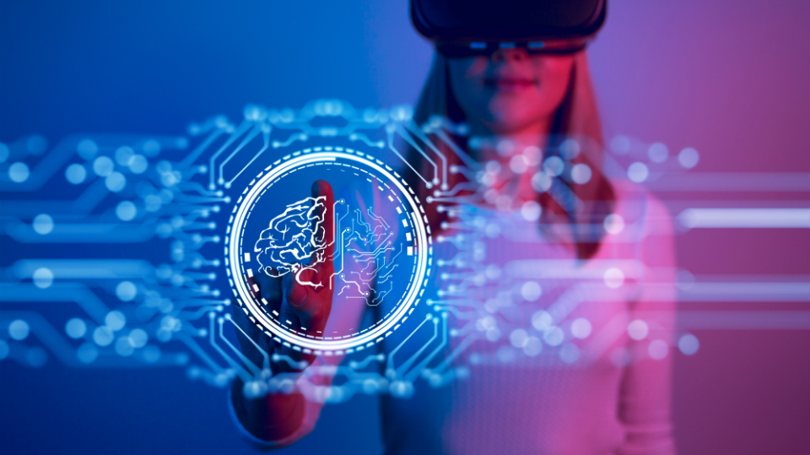
Fabrizio Sulpizio Projects

Slide 2
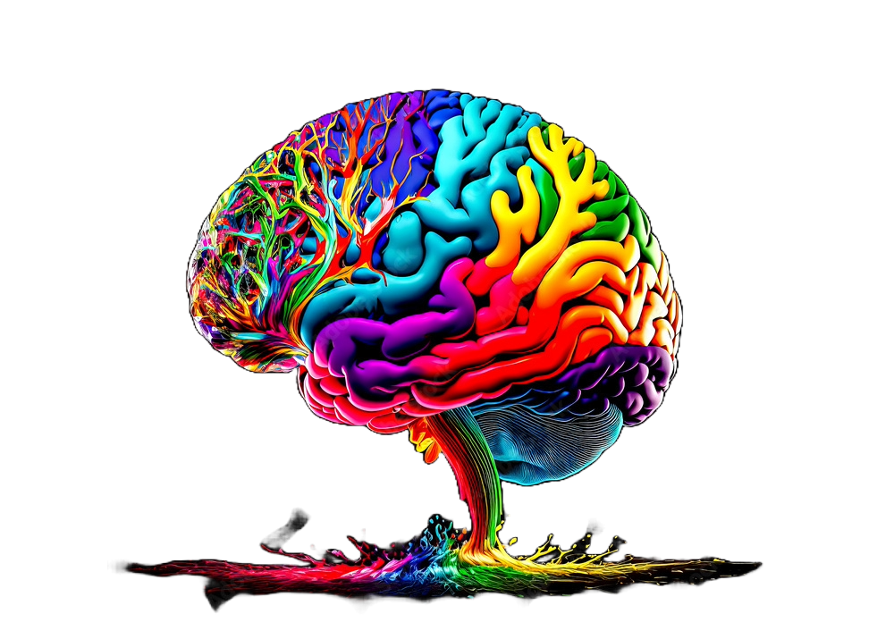

Metarehab: a Gamified VR app for neurodegenerative disorders rehabilitation (IEEE GEM 2024)
Features
Physical & cognitive stimulation
VR-based
Gamification
Hand tracking & automated pose recognition
Fine-grained hand movements
Indirect non-tracked muscles stimulation
Effects
More effective than the standard approach
At-home feasibility
Engagement
No need of constant medical supervision
Comprehensive rehabilitation protocol
Financial sustainability

Slide 3

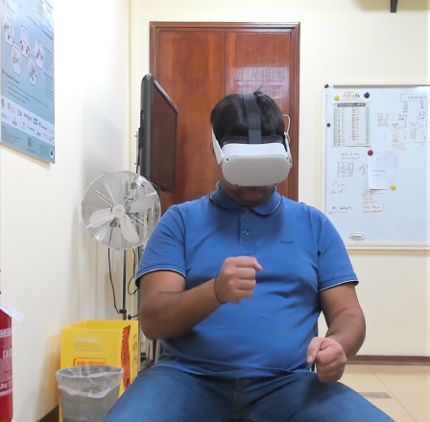
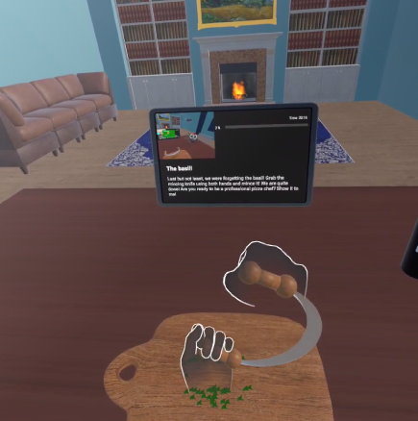



MetaRehab: An affordable, engaging VR system for independent home rehabilitation in neurodegenerative disorders

Slide 4
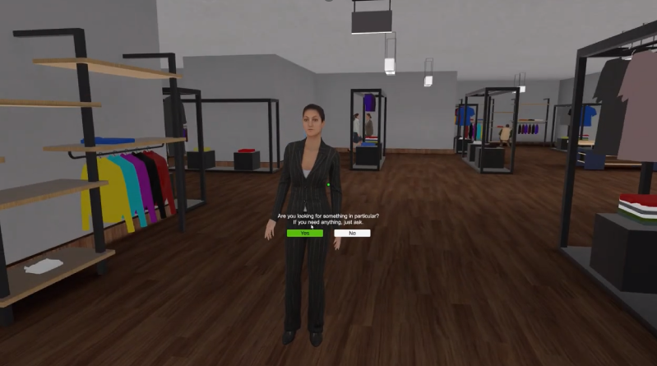
Aware: desktop VR for Social Anxiety

Slide 5
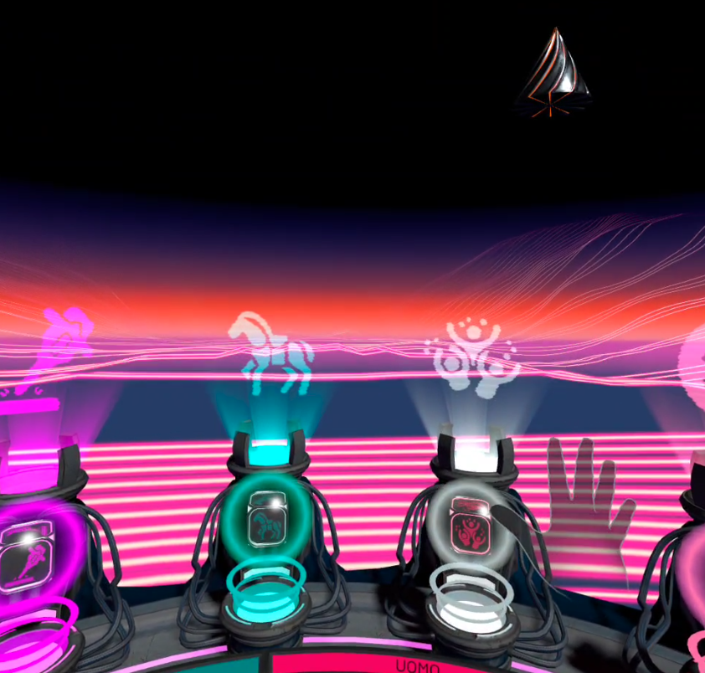
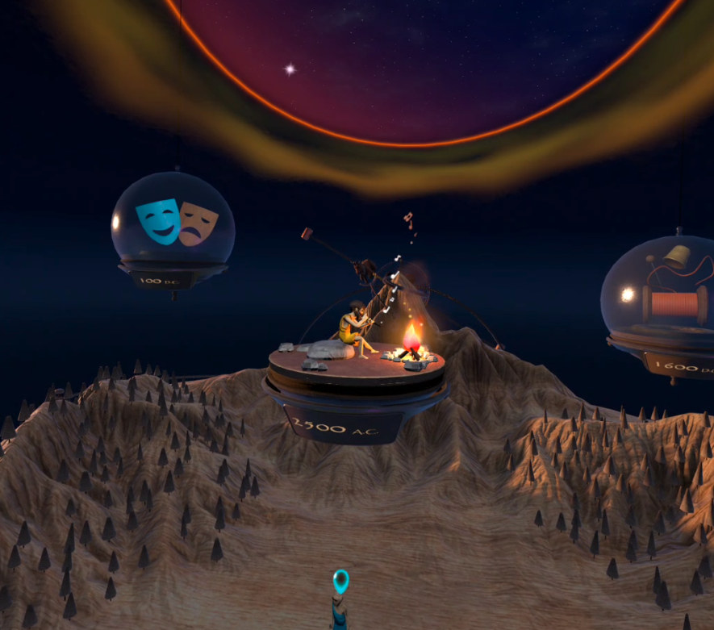
Alptech Project
Sense the City Augmented Aostae

Slide 6
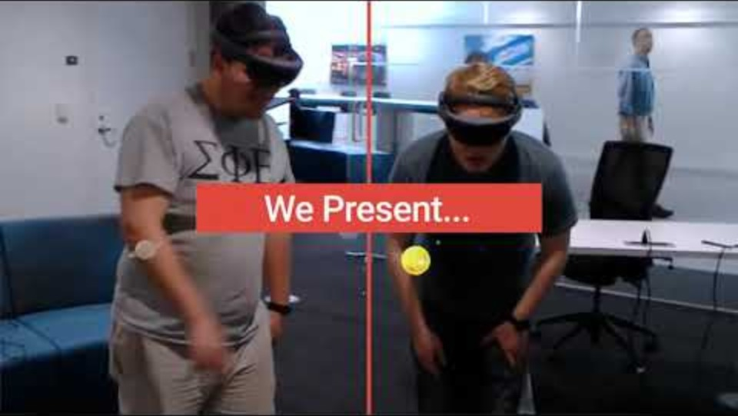
Holo-BLSD Mixed Reality based self-training and self-assessment tool for emergency first responder procedures in case of cardiac arrest.

Slide 7
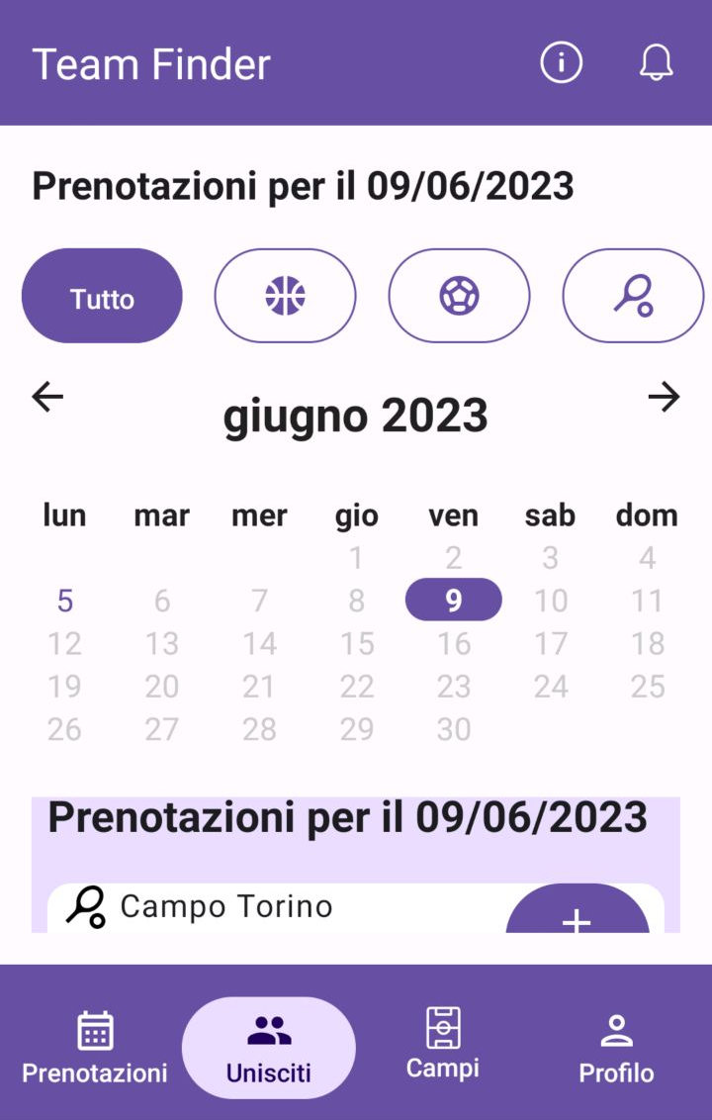
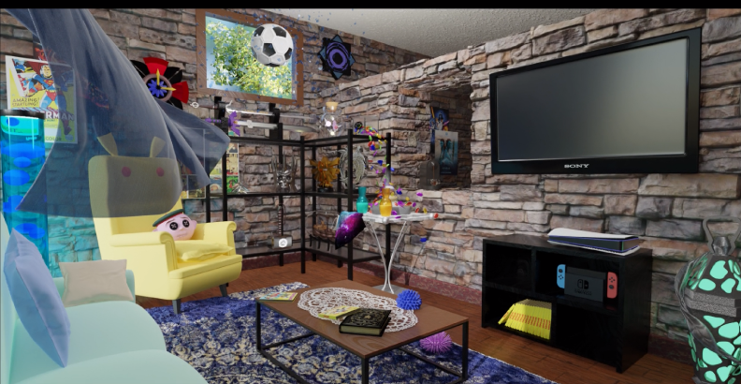
Other projects & accomplishments
Team finder -
Mobile app development
@ Polito
Computer Graphics @ Polito

Slide 8
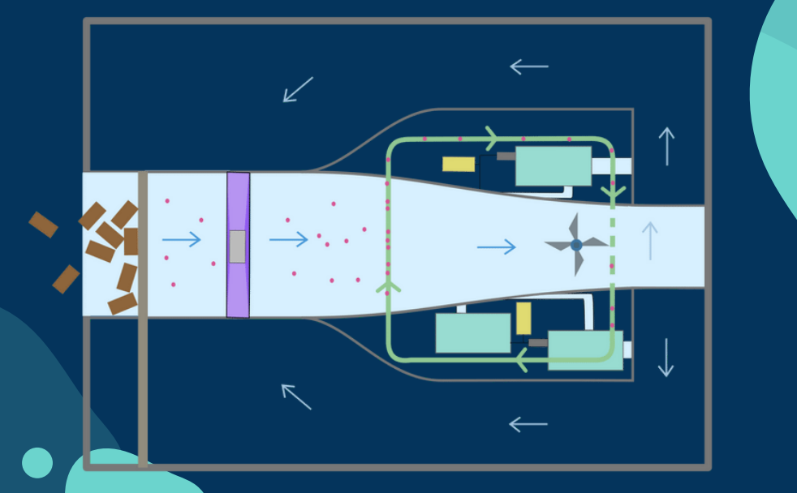
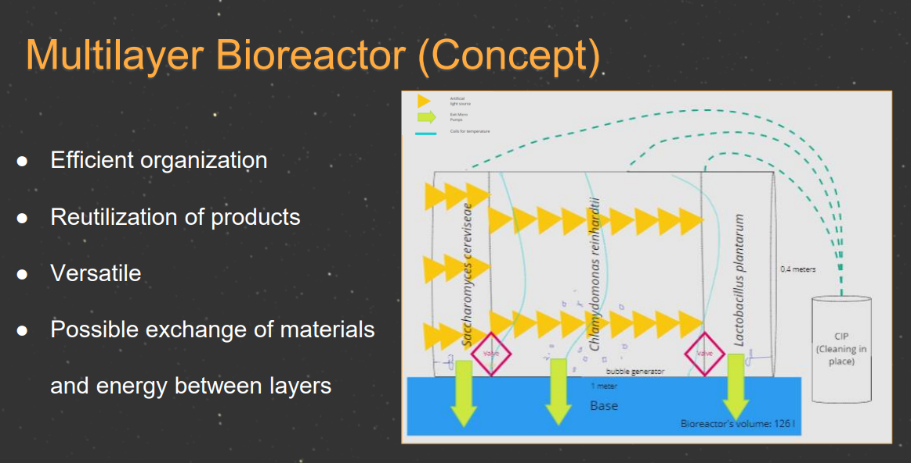
Other projects & accomplishments II
ULISSES 2022 – The University of Lisbon
Interdisciplinary Studies on Sustainable
Environment and Seas (winning project)
INSPIRED 2020 - International Project Week
for Interdisciplinary Research-Oriented
Digital Learning @ TU Darmstadt
Myme 2021 - Make Yourself More Employable, Erasmus+ project in Poland
Science & Human Rights by the Global Campus of Human Rights
Google IT support professional & Cybersecurity by AcademyRapido
Software Engineer - VR Game Design & Development Intern @ SynArea Consultants
Engineering Empathy, Machine Learning for Vision & Multimedia @ Polito

Slide 9
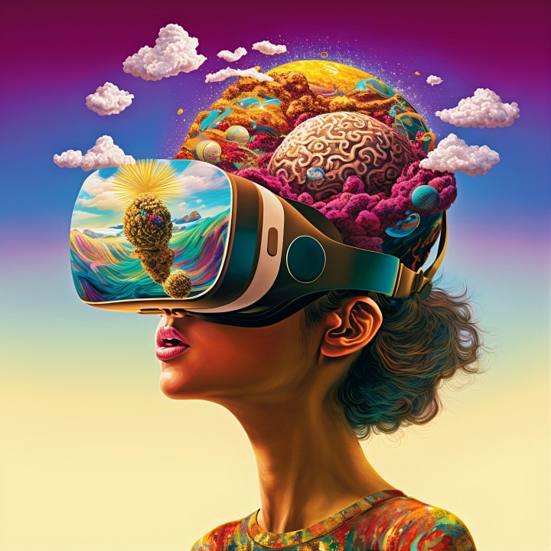
Thank you!

